Slide 1
2012 Meeting of the ILR
Plenary Session
February 10, 2012
“Meeting the need for high-level language Professionals: NSEP, The Language Flagship Model and Lessons and Challenges for Language Acquisition and Assessment at the Advanced and Superior Levels (ILR 2-3) Program”
Dr. Dan E. Davidson
President, American Councils for
International Education: ACTR/ACCELS
Professor of Russian and
Second Language Acquisition,
Bryn Mawr College
Notes:
1
1
1

Slide 2
The L-2 Learner “strives to speak, write, and understand those who use a different semiotic system, … to predict text from context, and context from text.” Besides everyday conversation, these social processes include the production and critical interpretation of cultural values, attitudes, and beliefs.”
Kramsch, 2002
“Dialogism applies to individual words and utterances, but also to the language system as a whole, which is embedded with the products of a continuing generalized collective dialog with “other” users of the language. To know a language, you must also “know” the general collective dialog.” A word is always half someone else’s. It has to be populated, adjusted, before it is yours. Words carry the scent of other voices.”
Jakob Shpet, Inner Form of the Word, 1927
“Much of what we loosely refer to as a word’s connotations may in fact be the stylistic aura resulting from the word’s usual generic context. Typical contexts seem to “adhere to words.”
Bakhtin, SG, 87, 1979.
Notes:
2
2
2

Slide 3
Study abroad research, like SA itself, focuses simultaneously on linguistic as well as intercultural communicative competence, as can arise naturally in a wide range of formal and informal social interactions in the overseas immersion setting.
Today’s presentation reports on Arabic and Russian Flagship program outcomes, as well as providing information on the overall system of interventions that are in place to support year-long overseas immersion, where students
make choices based on contexts that have real consequences
produce meaning with words (requesting, apologizing, thanking, etc.);
interpret situations requiring these speech acts;
monitor the appropriateness of their utterances (e.g., for register)
repair their utterances, as needed;
Learners need guidance in all of the above. As John Carroll (1963) and Ray Clifford (2012) have pointed out, time-on-task is a key variable, if not the principal variable, in adult instructed SLA.
Notes:
3
3
3

Slide 4
Simon’s Law: time-on-task alone is insufficient. Activity must be “effortful.”
For that reason, learning outcomes are compared with time-on-task, a systematic program of
goal-setting,
self-evaluation,
external evaluation, and
self-reflection
which accompany the formal and informal training and L-2 utilization components that make up the Flagship Program.
This is accomplished through the use of the online Language Utilization Reporting System (LUR).
Notes:
4
4
4

Slide 5
Need to examine the simultaneous development of L-2 and Intercultural Communicative Competence
Goal of overseas study – language and content learning with multiple perspectives, “multi-voicedness” (Byrnes), or hetero-glossia, similar to Bakhtinian dialogism.
AC Programs encourage a self-reflective stance: self-assessments, regular goal setting, expressions of attitude and appreciation, as well as holistic and analytic assessments of L-2 linguistic and related competencies.
Learning with a critical perspective (Byram) on both native and target languages and cultures, increasingly a pre-requisite of being an educated citizen in the 21st century: ICC = attitudes, L-2 and C-2 interaction skills (linguistic and behavioral), knowledge of L-2 and C-2, and the skills for critical interpretation (reading, listening), literacy (not just talking).

Slide 6
Basic Structure of the AC Overseas Programs
Academic Components (age appropriate)
Intensive language training in small groups
All overseas centers are native schools or universities
Direct enrollment courses or classes.
Regular twice weekly or daily meetings with peer tutor
Integrated cultural program (bi-weekly, tied to thematic units of the course)
Co-Curricular (age appropriate)
Integrated homestay or residential component
Internships
Volunteer opportunities
Optional discussion groups with native speakers (5-6 times per semester)
On-going evaluation (testing, site visits, teacher/tutor reports, portfolio development, self-evaluation)
Bi-weekly Language Utilization Reports (time-place, function)
Notes:
6
6
6

Slide 7
Direct Enrollments (Partial Listing)
Biochemistry and Viral Immunology
Advanced Probability Theory
Policy of the Russian Regions
Legal Regulations: Social and Political Conflicts
Orthodoxy and the Russian Philosophy of Culture
The Modern System of Defending Human Rights
The Technology of Election Campaigns
Philosophy in the XIX – XX Century
Economy of the Public Sector
The Institution of Conflicting Sanctions: History and Theory
Notes:
7
7
7

Slide 8
Current Internship Placements: Russia
Department of Economic Georgraphy (RGPU)
Likhachev International Humanitarian Fund
Center for NGO Development
Hermitage Museum- architectural archeology
Environmental Rights Center "Bellona"
Center "Strategiya" (SPB Think Tank)
St. Petersburg City Zoo and Large Animal Veterinary Center
Ernst & Young
The Civil Society Fund, Eu. Int. University
Leningrad Regional Press Service Center
Magazine "Art & Times"
City Hospital #2. Endocrinology Division.

Slide 9
Language Utilization Report (Specimen)
Student Name
Started: Not yet started — Completed: Not yet submitted.
Due: Sep 16
Language Use
How many clock hours during the past 7 days did you spend using Russian in the following activities (remember that your individual language classes last for 90 minutes each). Please use decimal-point notation, i.e. 1 hr. — "1"; 45 min. — "0.75"; 30 min. — "0.5"; 20 min. — 0.30; 15 min. = "0.25"; 10 min. — "0.15". Please only record the activities for ONE week. Do not Add the time for the two week period of the report.
Notes:
9
9
9

Slide 10
II. Communication Challenges
A. What challenges did you encounter during the past week in operating in Russian?
(Consider interpersonal, interpretive, and presentational modes in responding, e.g., scanning detailed text for relevant information, understanding detailed written instructions or spoken advice, note taking, letter writing, holding the floor in a discussion, reacting appropriately to a culturally "sensitive" situation, etc.) Describe the situation briefly.
B. In view of the challenges described above, what language/cultural resources will you need to master or have greater control over to deal more effectively, when a similar situation arises in the future?
III. Communication Successes
Describe a linguistic interaction in Russian during the past week which might be
seen to characterize your command of Russian at its best.
(This may be an interaction of any kind which you consider you handled well.)
Notes:
10
10

Slide 11
IV. Goals for the Month(s) Ahead
Identify 2-3 thematic areas, language functions, or speech genres which you plan in the coming weeks to make stronger in your own Russian.
(E.g., getting better at making requests or offering apologies, understanding certain recurrent colloquialisms in the speech of friends, catching references to contemporary Russian culture and/or politics, mastering abstract expressions, learning how to keep up a conversation, improving phonetics/intonation, becoming more proficient at offering toasts, responding to compliments, invitations, leading a discussion, chairing a meeting, etc. )
V. Additional Comments
Please note any other observations that come to mind about your use of Russian during the past week?
Notes:
11
11

Slide 12
Language Utilization Reporting 2004-2011: Descriptive Statistics
Activity | N | Minimum | Maximum | Sum | Mean | SD
Number of forms completed | 65 | 7 | 32 | 1043 | 16.05 | 6.77
Formal language learning classes | 65 | 105 | 265.5 | 11686.65 | 179.79 | 35.85
In homework and other preparation for formal language learning classes | 65 | 0 | 410.5 | 6277.7 | 96.58 | 94.2
Internship or specialization coursework | 65 | 9 | 225 | 5218.42 | 80.28 | 40.83
Language tutorial sessions | 65 | 7 | 113.9 | 2994.5 | 46.07 | 14.97
Professional or academic reading | 65 | 0 | 161 | 2212.6 | 34.04 | 37.26
Cultural events | 65 | 0 | 104.5 | 2304.4 | 35.45 | 24.32
Host family | 65 | 0 | 345.25 | 7514.68 | 115.61 | 83.59
In public transportation or while shopping | 65 | 0 | 175.9 | 2980.57 | 45.85 | 44.53
Other | 65 | 0 | 116.5 | 1427.1 | 21.96 | 28.59
Reading for pleasure | 65 | 0 | 161.1 | 3623.45 | 55.75 | 38.66
Reading the press | 65 | 0 | 114 | 2535.69 | 39.01 | 26.67
Local radio or television | 65 | 5.3 | 220 | 4798.75 | 73.83 | 43.65
Time spent with friends | 65 | 3 | 628.5 | 10761.05 | 165.55 | 107.52
Total hours in all activities | 65 | 368.8 | 2140.6 | 64335.56 | 989.78 | 349.55
Total hours spent on academic activities (language class, homework, tutorial, and academic read) | 65 | 147.3 | 720.5 | 23171.45 | 356.48 | 143.31
Total hours spent on three academic activities (language class, homework and tutorial sessions) | 65 | 130 | 696 | 20958.85 | 322.44 | 129.25
Total hours spent on reading activities (professional/academic reading, reading for pleasure, and reading the press) | 65 | 7 | 301 | 8371.74 | 128.8 | 71.5
Notes:
12
12

Slide 13
NSLI-Y Program Demographics
Number of Languages | Number of Participants | Average Age
7 | 656 | 17
CLS Program Demographics
Number of Languages | Number of Participants | Average Age
13 | 585 | 23
Flagship Program Demographics
Number of Languages | Number of Participants | Average Age
5 | 250 | 23
Notes:
13
13

Slide 14
“Language is the first step in understanding a nation’s principles and appreciating its past. Dance, like language, articulates a story and allows one to communicate. In studying both the Russian language and ballet, I gained a unique perspective on the nation’s history and established strong cross-cultural relationships. The language unlocked the world around me, but ballet gave me an intimate glimpse at the reverence and appreciation Russian’s harbor for the performing arts.”
NSLI-Y Russia, Summer 2010
Level I: ICC differences assessed, aided by language and high culture; affect.
Notes:
14
14

Slide 15
Level 2: (Limited Working Competence)
Able to participate acceptably in many everyday social and work-related interactions.
Shows conscious awareness of significant differences between the individual’s own culture and the other culture and attempts to adjust behavior accordingly, although not always successfully.
Can typically avoid taboos and adhere to basic social norms and rules of etiquette, such as in accepting and refusing invitations, offering and receiving gifts, and requesting assistance.
May sometimes misinterpret cultural cues or behave inappropriately for the culture, but is usually able to recognize and repair misunderstandings.
Normally functions as expected in predictable and commonly encountered situations, including public events and large gatherings, but may have difficulty when faced with less familiar circumstances.
Able to participate in various social media activities. In a work environment, can appropriately issue straightforward directions and instructions, give or receive orders, whether in person, on the telephone, or in writing, and may be able to address some job-related problems.
In some instances, demonstrates recognition of and makes appropriate reference to issues and topics that are customarily the subject of conversation, such as historical, cultural or current events.

Slide 16
“My favorite part about studying in my host country is bargaining with vendors. I have found that there are few forms of Chinese study better than practicing your bargaining skills; you learn not only to think on your feet and respond quickly in local vernacular, but also how to relate to Chinese locals and discuss your experiences as you build the “guanxi” (relationship) necessary for a win-win deal.”
CLS China2011
Level II participates acceptably in many routine intercultural interactions, including work-related.
Notes:
16
16

Slide 17
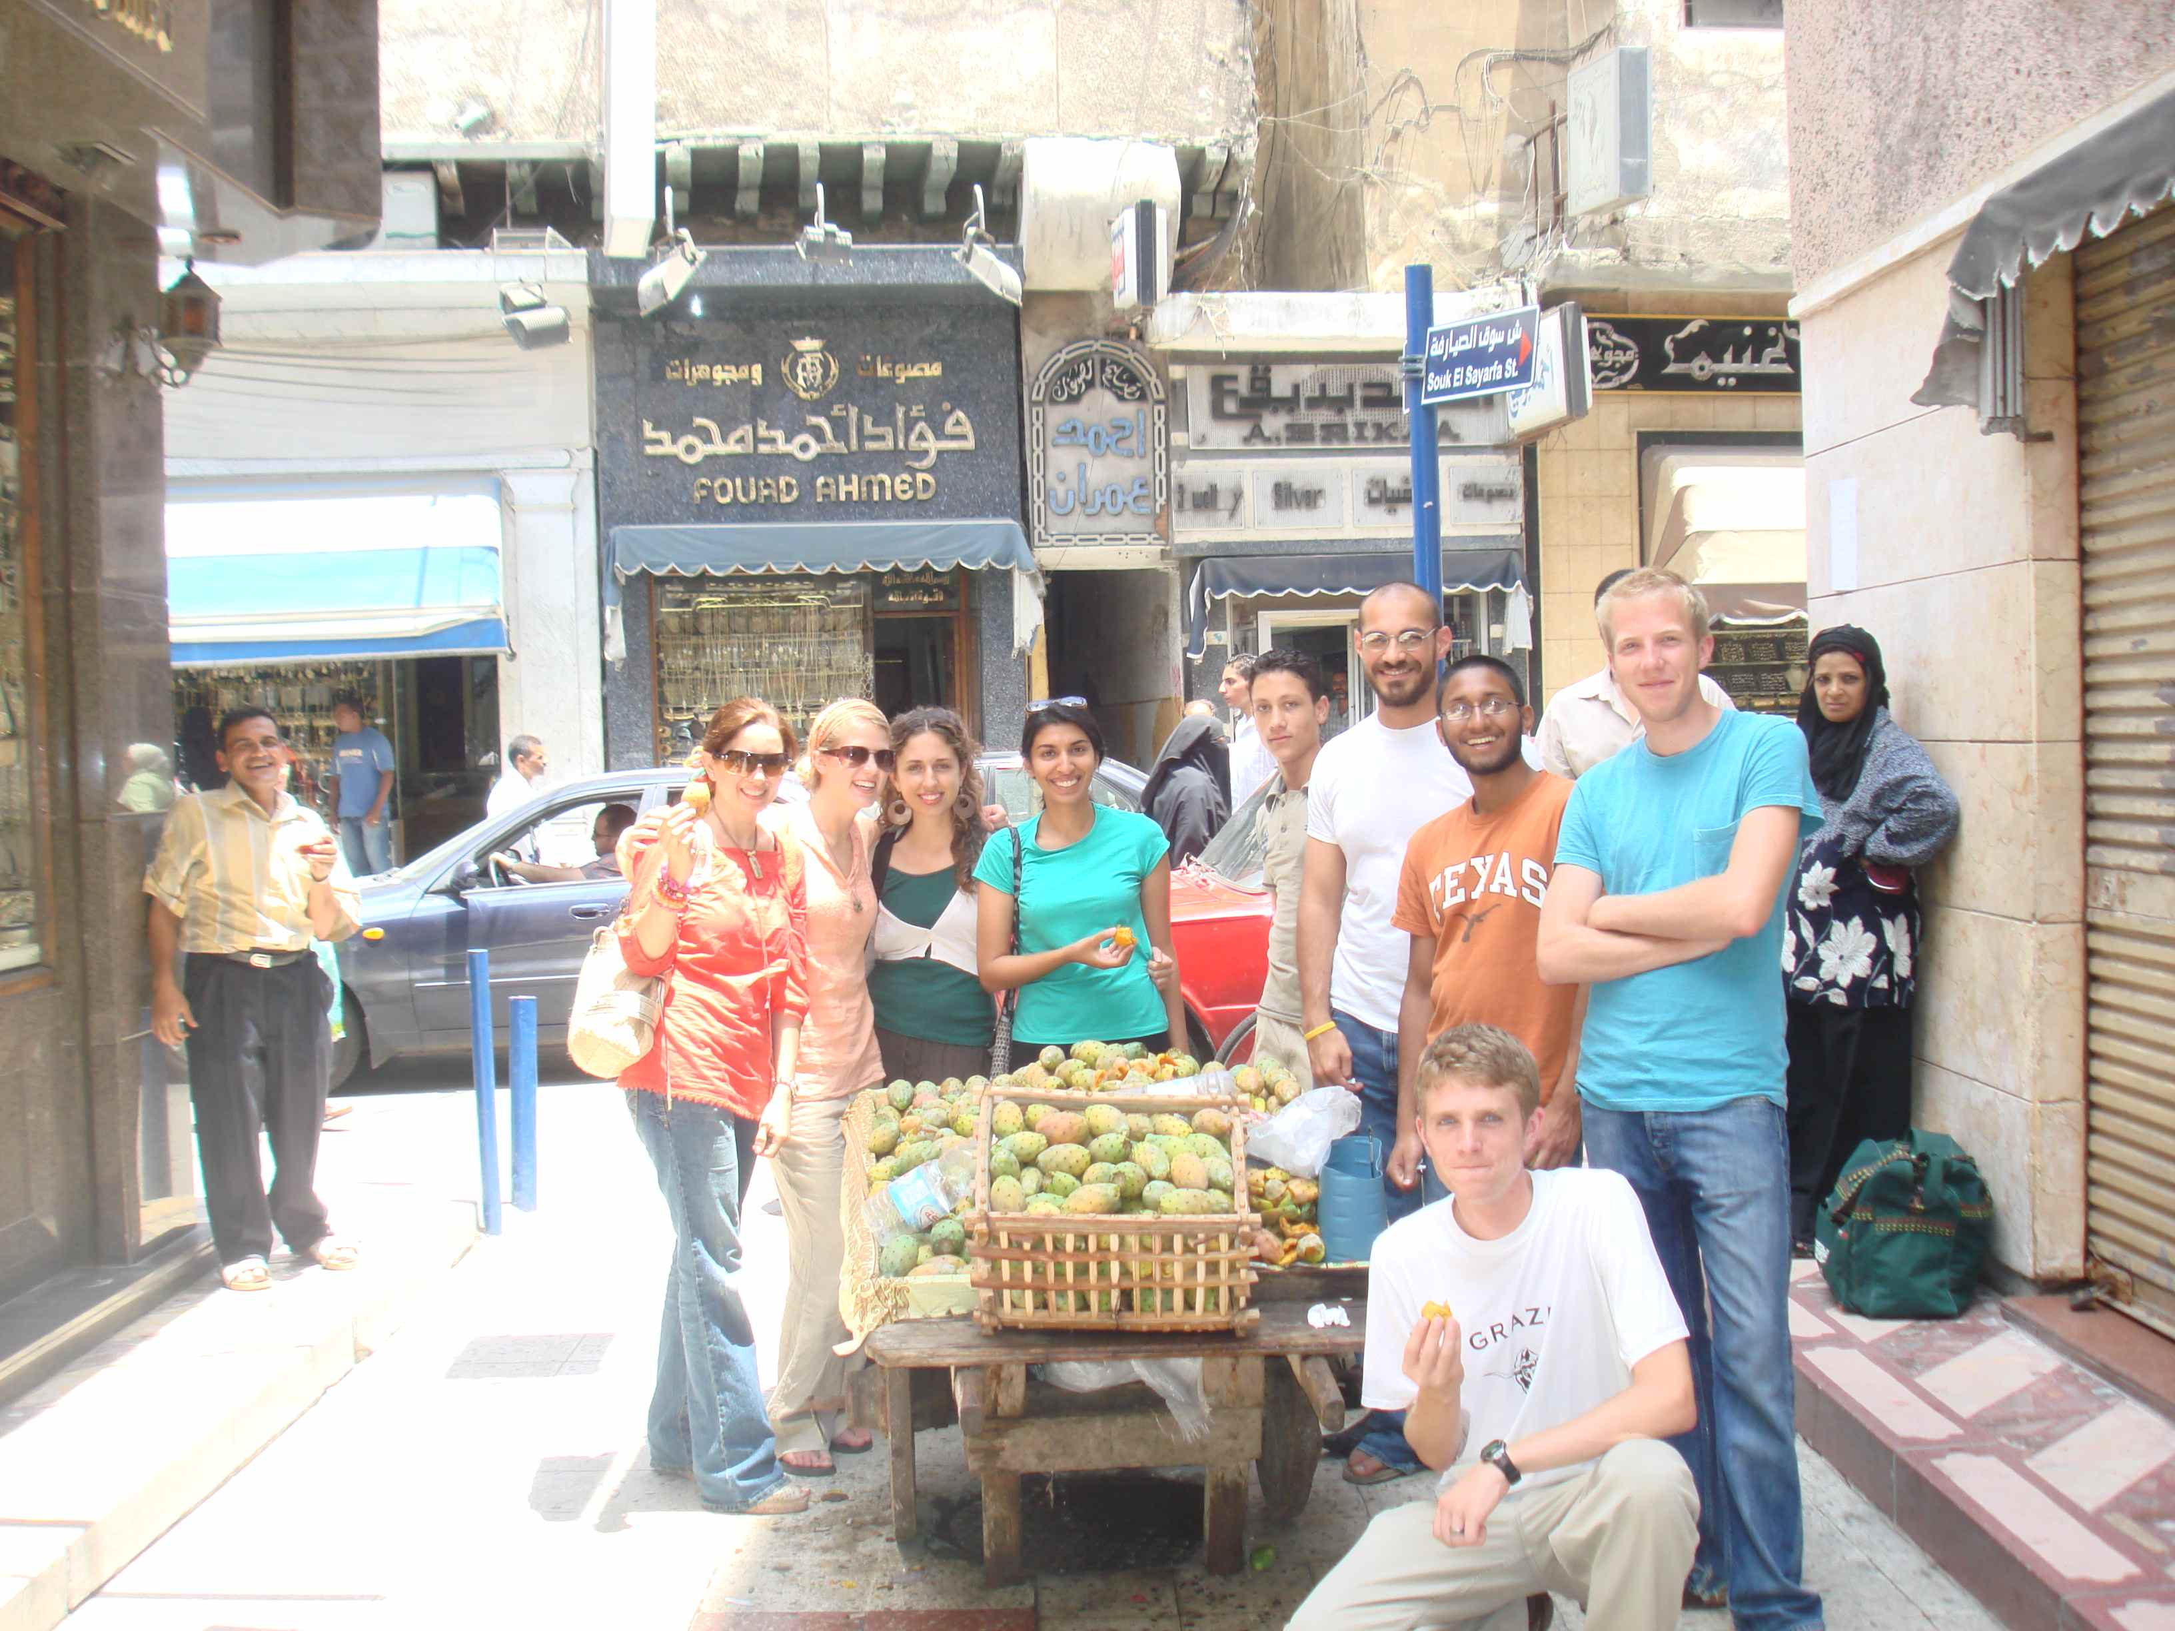

Slide 18
“One of our CLS Turkey 2010 students practiced her Turkish and shared American culture with Turks through everyday activities like getting her hair cut: “While a trip to the barber does not have the outward appearance of a culturally enlightening experience, my visit speaks to the heart of the scholarship’s mission… I was able to connect with a Turk, who has had little – if any – exposure to real Americans. While Erhan may have seen every episode of Lost, and memorized all of Rhianna’s lyrics – I was able to show him what a ‘real’ American is like.”
CLS Turkey 2010
Level I and II: “the third place” (Kramsch), understanding ones own culture in a bi-focal way and appropriate interpersonal exchange.
Notes:
18
18

Slide 19
“I now realize that I came to Azerbaijan with a preconceived notion that I would find nothing positive about the subservient role of women in traditional Azerbaijani culture. As a very independent American female, it was difficult for me to adjust to the gender division in Azerbaijan, because I felt that women were treated as second class citizens. To show respect to my relatives, I tried to abide by their cultural norms and remained segregated with the other women. The women prepared food and served the men, cleaned up after them and waited until the men had finished before being allowed to eat. Although this aspect of Azerbaijani culture was difficult for me to accept, I also came to realize that this gender division has some positive aspects. I found a deep sense of camaraderie among my female relatives that I have not experienced before. There was a complete sense of freedom in the way my female relatives expressed their feelings, concerns and insecurities, knowing that they could reveal anything and still be accepted for it. They relied on always having a group of other women around to socialize with, which provided an ongoing sense of security.
I learned that loneliness is almost a foreign concept to my Azerbaijan female relatives. They are never alone and never worry about being alone. My female relatives all share in their household work and child care. In contrast to many of my American female friends, who feel that they sometimes have to take on the world themselves, my Azerbaijani relatives know that a helping hand is always available, without needing to ask for it. Overall, I experienced a deep sense of community and family respect that I feel that is often lacking in western cultures. Independence, for all of its positive aspects, also comes with a price and my stay in Azerbaijan made me realize this.”
Heritage speaker CLS Azerbaijan, 2011
Level 3 able to interact in a broad range of public and private situations with dual perspective.
Notes:
19
19

Slide 20
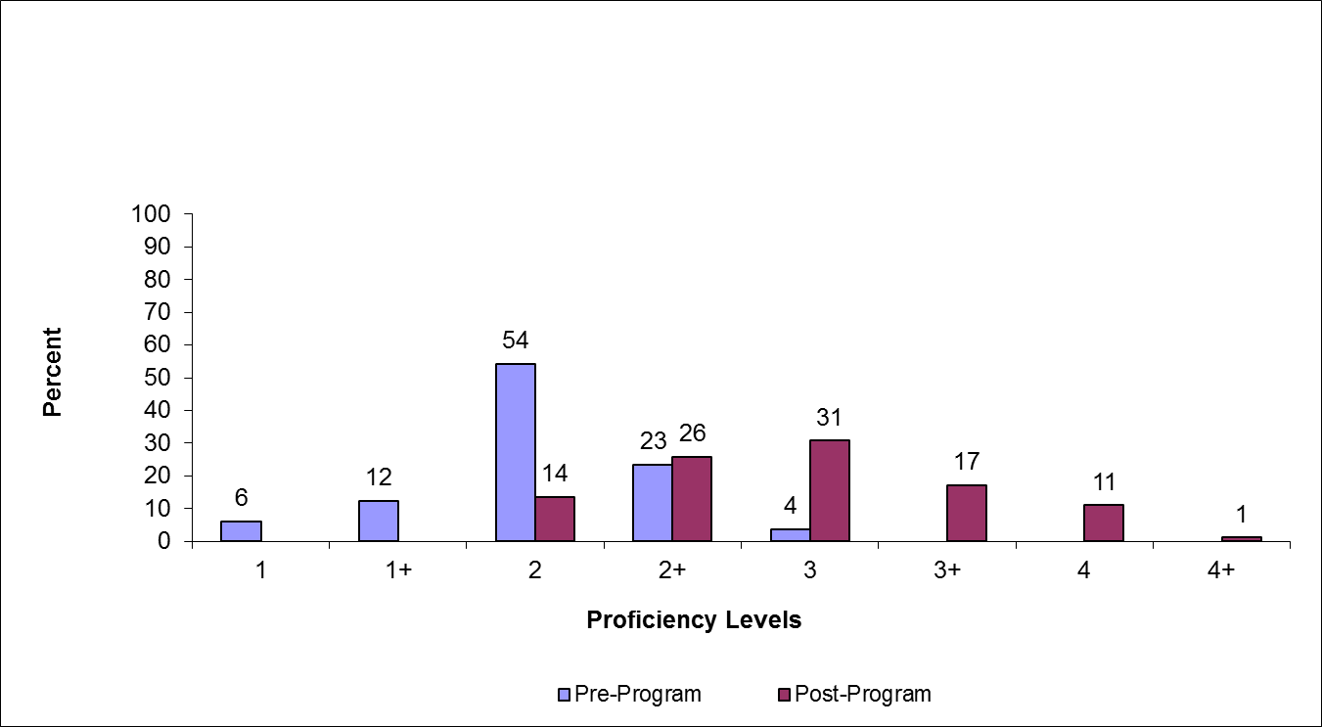
Arabic Overseas Flagship Program (N=81) OPI Scores for 2007- 2011 Academic Year Program

Slide 21
Comparisons of Pre- and Post-program Reading Scores: Arabic Overseas Flagship Program, 2009-2011 (N=57)

Slide 22
Comparisons of Pre- and Post-program Listening Scores: Arabic Overseas Flagship Program, 2009–2011 (N=57)

Slide 23
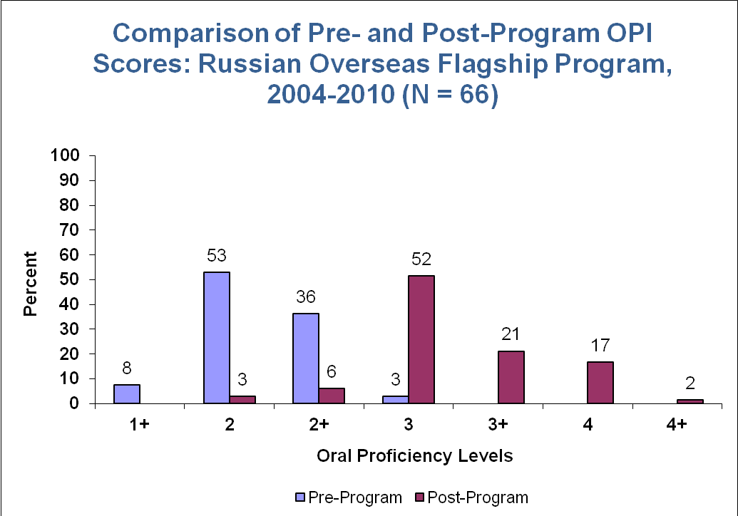
Notes:
23
23

Slide 24
Notes:
24
24
24

Slide 29
Summary of Multiple Regression Analyses for Variables Predicting Gain in Oral Proficiency:
AY/Flagship Students (N = 69)
Notes:
29

Slide 30
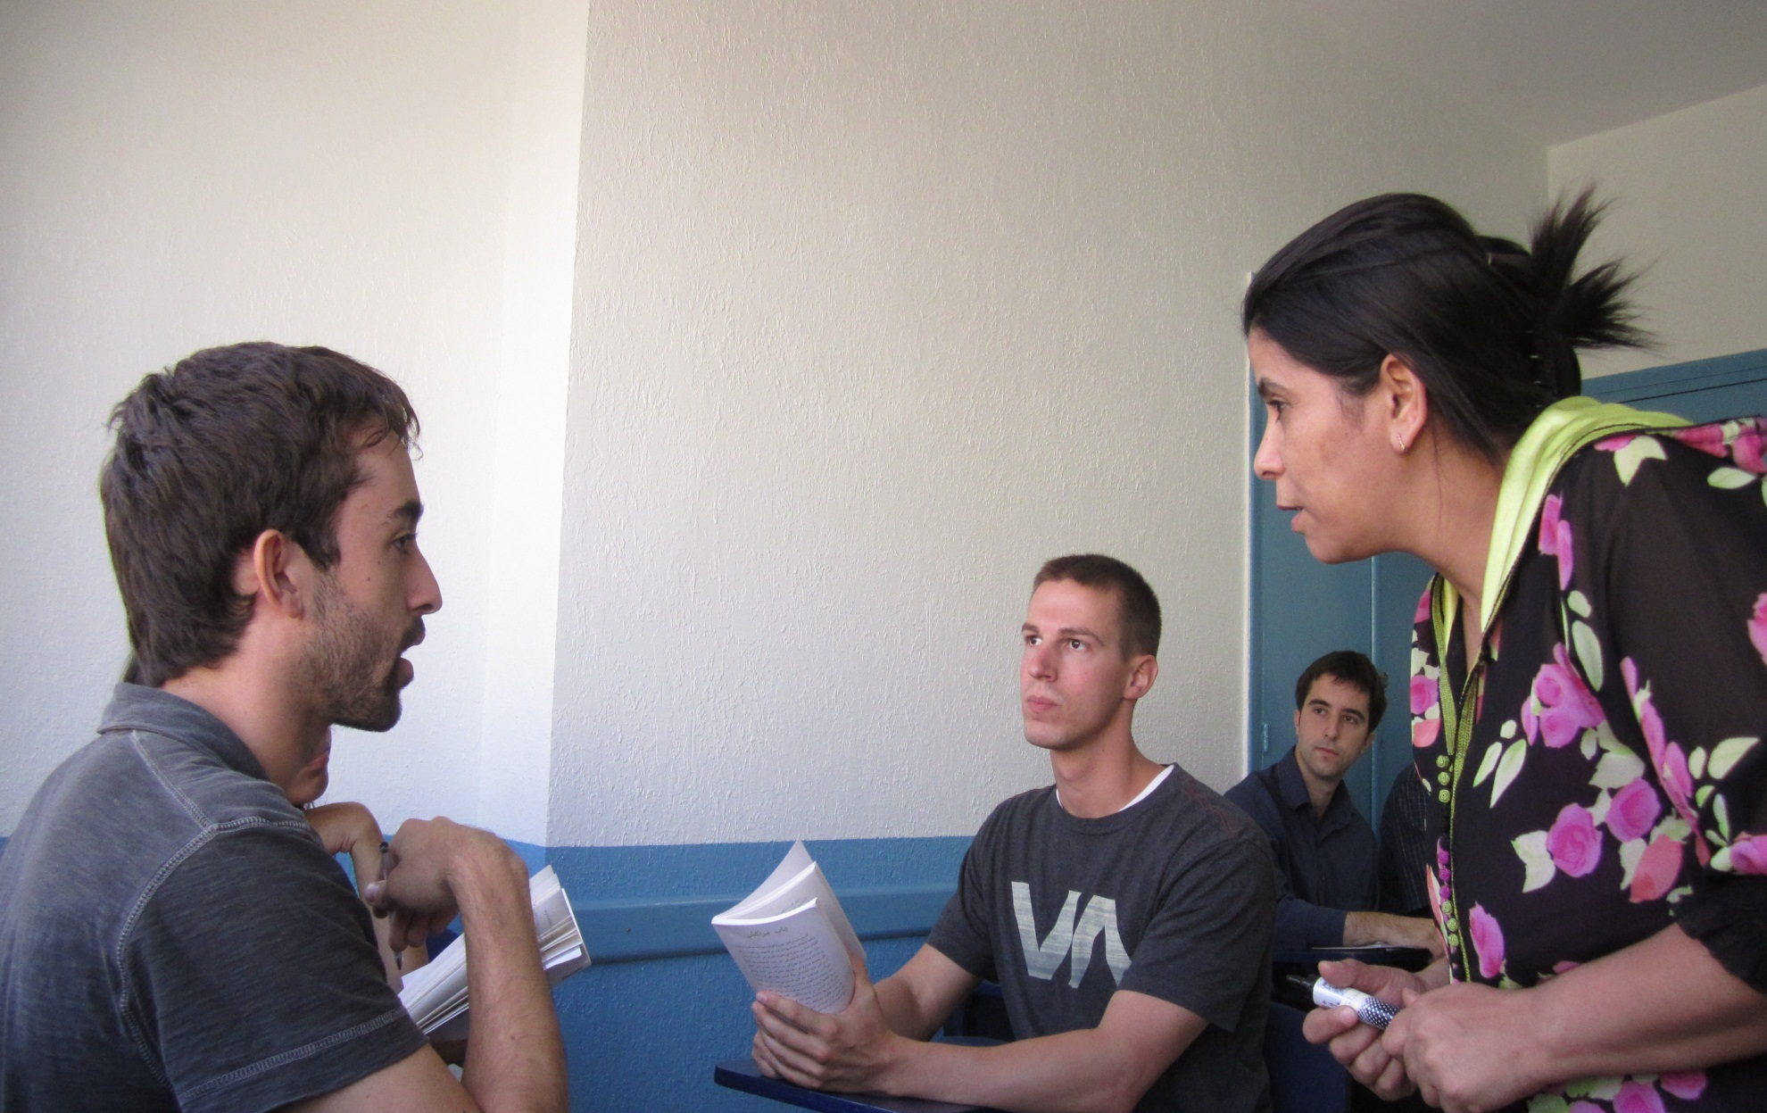
Notes:
30

Slide 31
Russian Overseas Flagship: Mean Weekly Time-on-Tasks (in Hours) by Activity Type
Activity | Post-test OPI 2/2+ (N=5) | Post-test OPI 3 (N=34) | Post-test OPI 3+/4/4+ (N=26)
Homework | 0.9 | 4.9 | 7.9
Internship | 6.6 | 6.2 | 4.8
Tutoring | 3.1 | 3.1 | 3.0
Academic Reading | 4.7 | 2.0 | 2.4
Cultural Events | 1.2 | 2.3 | 2.7
Host Family | 5.3 | 6.8 | 8.8
Reading for Pleasure | 0.7 | 3.7 | 4.2
Following the Press | 2.1 | 2.6 | 3.0
Local TV/Radio | 3.3 | 5.3 | 5.0
Time Spent with Friends | 6.9 | 11.2 | 10.9
Notes:
31
31
31

Slide 32
Percentage of Total Time Spent in
L-2 Activities
Friends 15%
Host Family 13% (3+), 9.5(3), 8.6(2+)
Academic 40%
Reading 14% (3+), 11%(2+/3)
Cultural events 4%(3+), 3.1% (3), 1.7% (2+)
Internships 10%
Other 4%

Slide 33
“A couple of times a week I sit with Syrian student that rents a room in my homestay house and speak with him about life in Syria and America. We sat and spoke for an hour or so about life in the United States, and I felt that I played a diplomatic role by explaining to him American values and traditions, religion in American, and I even explained the complexities of the American political system and the roles of the three branches of government”.
Arabic Flagship, Level II

Slide 34
During our class on the Arabic novel we are reading I was able to convey abstract meanings such as the definition of patriotism and nationalism. This is something that would have been very difficult for me in the past.
Arabic, Level II-III

Slide 35
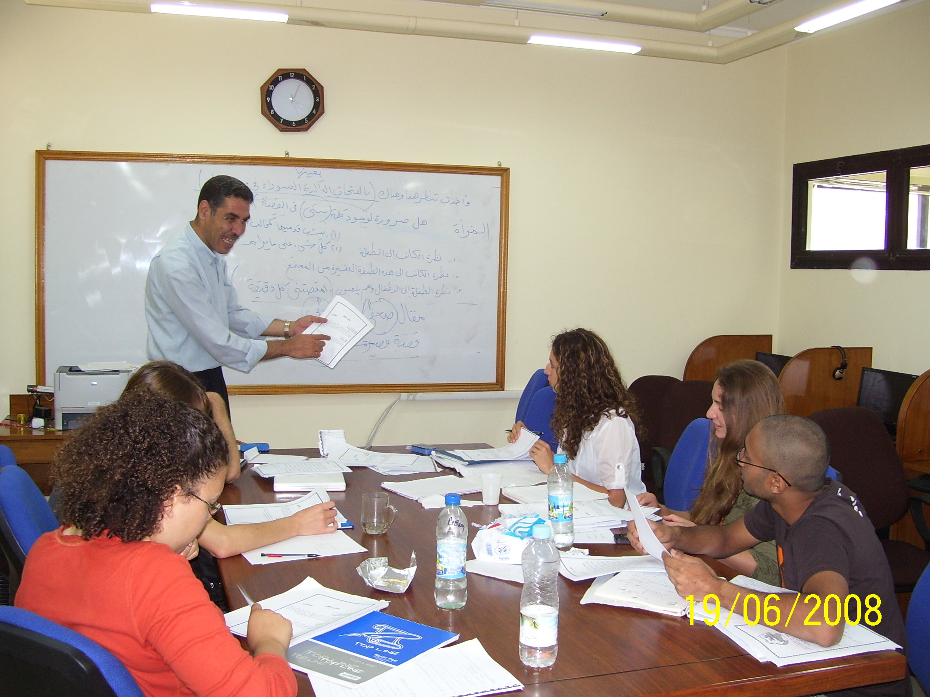

Slide 36
“The biggest success I have had so far is while talking to cab drivers. Most cab drivers are extremely pleased if you speak any Arabic at all, and while I know that their opinions aren't the most important, it is an excellent confidence boost and makes me more comfortable practicing new words and phrases”.
Arabic, Level II

Slide 37
“This weekend I went to my friend Asmaa's house out in the country near Tanta, and visited with her family, went to an engagement party, and saw a prospective husband come out to meet and greet her...! It was an incredible experience, I spoke nothing but Arabic for 2 days, I learned a TON about the culture and family life that Asmaa is a part of, and had a lot of awesome food!”
Arabic, Level II

Slide 38
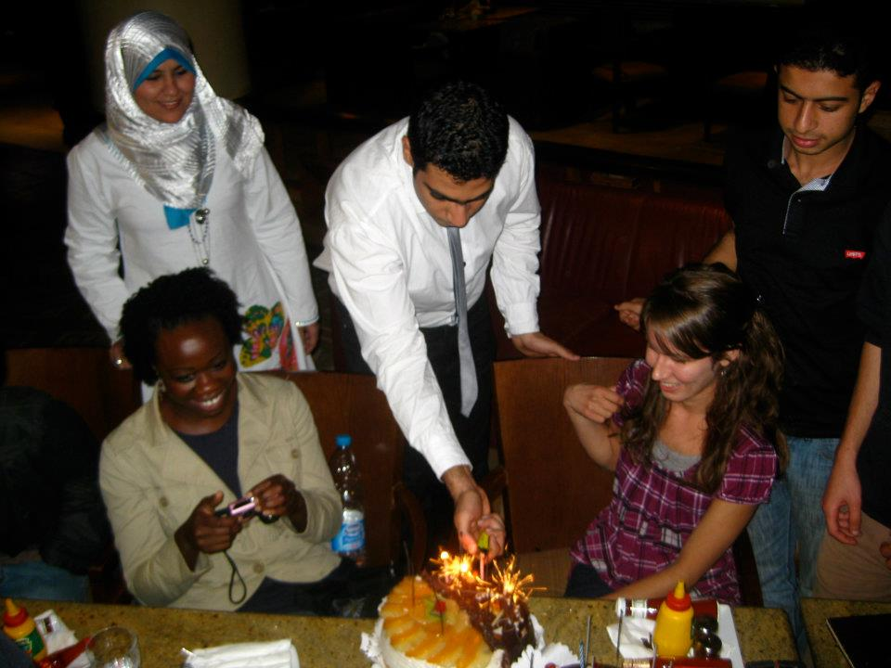

Slide 39
“I attended a Church service in Alexandria on Friday morning and afterwards I was talking to a group of people about life in Egypt and what they think of the upcoming elections. They and I were amazed at my ability to contribute intelligently to the conversation and understand them speaking Egyptian colloquial at a normal speed. Although I have only been in Egypt for one month, I can understand 85% of what people are saying”.
Arabic, Level II

Slide 40
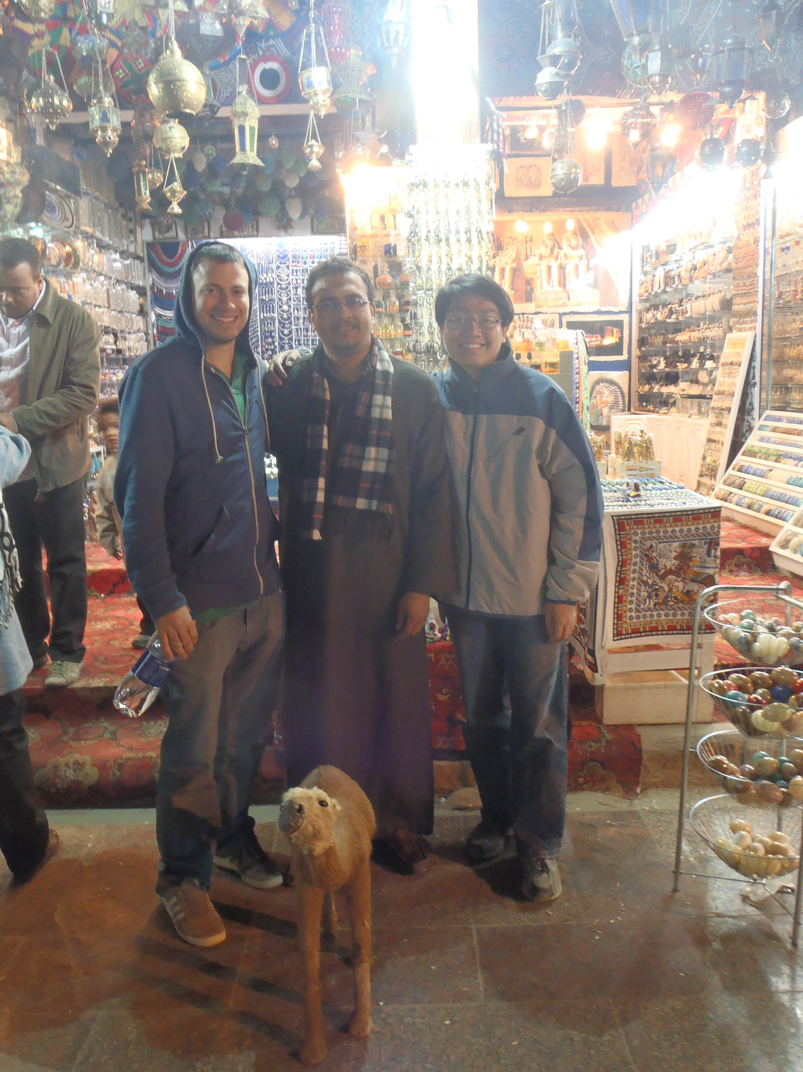

Slide 41
“I haven't felt the need to speak English with any of my classmates or otherwise. I consider this an accomplishment because it means I have become able to get around expressions I don't know in Arabic by using explanation or alternative expressions.”
Arabic, Level III

Slide 42
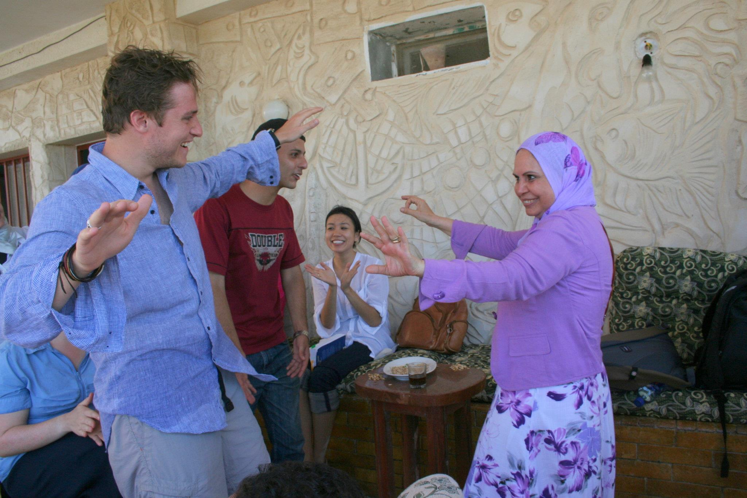

Slide 43
Pathways to 3 and above: What the evidence shows
Language Utilization in the Overseas Immersion Context: Factors affecting
L-2 Gain at Level 3 and above:

Slide 44
Characteristics of Level-3 Interlangauge*
(L-2 Russian)
Positive Salience
  Word Choice
  Formulation of Thoughts, Expressions
  Precision and appropriateness of cultural referencing
  Meta-linguistic Strategies
  Overall precision and faithfulness to “literary norms” of language use.
*Fedchak (2007), Bryn Mawr Dissertation

Slide 45
Characteristics of Level-3 Interlangauge*
(L-2 Russian)
Negative Salience (rank ordered):
  Word choice
  Lexical collocations
  Aspect, esp. in bound contexts
  Low frequency case/syntactic forms
  Socio-cultural Context (relating speech intentions to audience needs)
  Socio-pragmatic strategy selection

Slide 46
Word Choice and Register
Sudden shifts in register (up/down)
Most serious detriment to effective communication at Level –3
Effect goes beyond distraction to undermine rapport/trust between interlocutors;
NS Reactions to register shift may be very strongly negative; communicative failure is a possibility

Slide 47
Socio-pragmatics at Level 3
Strategy selection is culturally bound and rarely taught:
  Requests (idyocentric/allocentric)
  Apologies (locus of control)
  Persuasion (cajole versus challenge)
  Admonition (praise, then criticize)
  Expressing disagreement (rhetorical skills also culturally textured)

Slide 48
From The Subjective Worlds of Russian and American Youth: Success/Успех
The most important indicators of success for Americans are money and material possessions, as well as power. Success to Americans is a matter of business, achievements, and personal performance.
Russians think of success as joy, happiness, love, well-being, and satisfaction. Work and labor are also sources of success. Russians view success somewhat fatalistically and as a matter of luck.
These differences in perspectives reflect social experiences between the two systems, one which glorifies business and entrepreneurial skills and one which glorifies work.
N = 1723 US, 1555 Russia

Slide 49
Level 3: (Professional Competence)
Able to participate successfully in most social, practical, and professional interactions, including those that may require a range of formal and informal language and behavior.
Can adapt to a variety of individuals and groups without being misconstrued and transition smoothly from informal to formal styles of communication.
Controls nonverbal responses, such as gestures, and handles unfamiliar situations appropriately, including those involving taboos or emotionally-charged subjects.
Rarely misreads cultural cues, and can almost always repair misinterpretations.
Can understand and make appropriate use of cultural references and expressions, and can usually discuss a variety of issues and subject matter that refer to the culture, such as history, politics, literature, and the arts.
Can interpret reading materials and recognize subtleties, implications, and tone.
Able to communicate via social media. In professional contexts, the individual can interact appropriately during meetings and provide detailed explanations or reports both in person and in writing.
Social behavior and interactions reflect significant knowledge and understanding of cultural expectations.

Slide 50
“I began to get really ambitious ideas about writing poetry in Arabic. I did eventually write some poems in Arabic. I met a 'leader' from Sohag and a former member of the Egyptian Parliament with my friend Mohammed. I spoke well and was well received. I played my role as a cultural ambassador well.”
Arabic, Level III

Slide 51
“Today I was talking to my host mom about her Easter cake and I felt like my command of the language was reflected in my ability to produce a diverse range of compliments about her cooking. I got a dialog going with her, all based on compliments on the cake, whereas in September I would have just said the case was “tasty”, and left it at that”.
Flagship 2010
Level III: ICC mediated through expanded mastery of a broader range of sociopragmatic strategies and tools.
Notes:
51
51

Slide 52
“Met a famous Arab novelist and screenwriter at a restaurant, and sat with him (and three other Flagship students) for a while. Even though I didn't talk much, I was happy just to understand every word that he said.”
Arabic, Level III

Slide 53
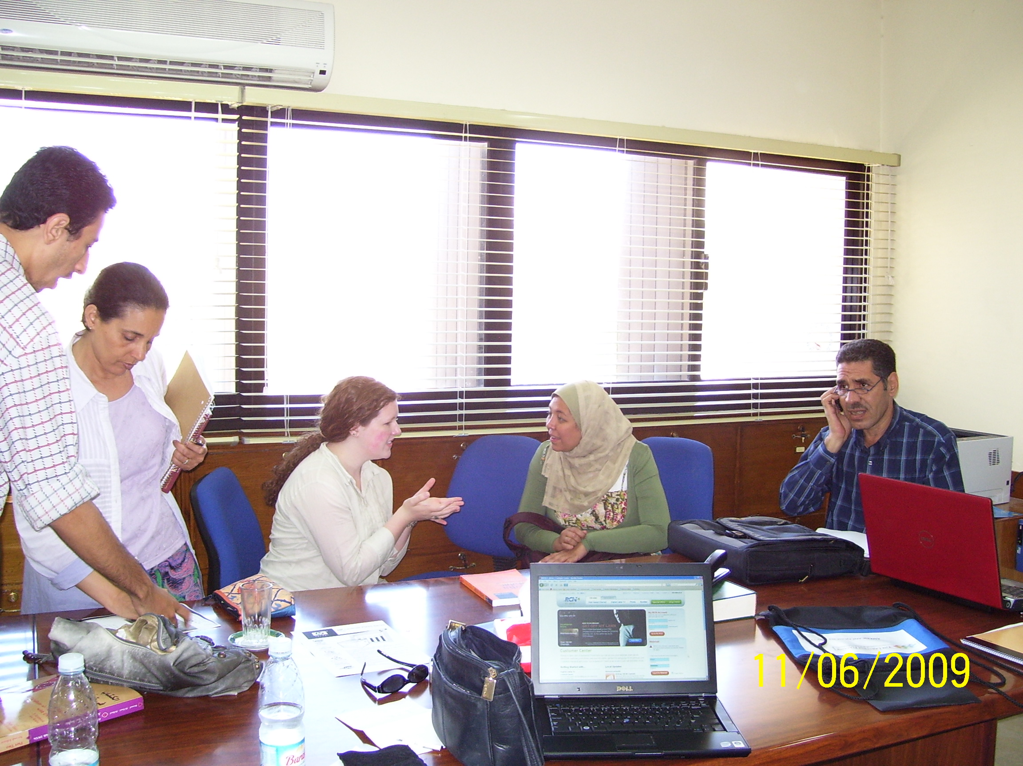

Slide 54
“It seems to me that the only approach here is to be as involved as possible in the everyday life of my host family, which I have already been trying to do. The main thing to remember is taking an interest in the life in front of my eyes here at home”.
Flagship 2010
Multi-level self-management strategy for mastering ICC within the host family context.
Notes:
54
54

Slide 55
“As long as I’ve been in Russia, I still have not been able to get used to some of the forwardness and seemingly angry intonation of the Russian people. This past week I had a couple of encounters with Russians, which left me in almost a foul mood, due either to their forwardness (bordering on reproach) or intonation. Both encounters left me feeling uncomfortable, to say the least”.
Flagship 2010
Level 2: shows conscious awareness of significant differences in host culture and ones own, but not always able to adjust behavior to them.
Notes:
55
55

Slide 56
“Holding my own in a conversation. More specifically, I didn’t say a word while a bunch of my host mom’s well-meaning but incredibly offensive friends told me that my fiancé is probably just using me as a ticket out of Georgia. This was za stolom, a celebration of Pascha and Galya’s birthday combined. They were all significantly older than me (in their 50s and 60s), and all talking at once, and all rather loudly. I didn’t feel comfortable interrupting (although I know it wouldn’t have been offensive to them — I just can’t seem to shake that part of my upbringing), and I didn’t feel comfortable telling them to mind their own business. I need to figure out how to say “Thanks for your concern, but I’ve got this one covered.” And introduce a new topic of conversation”.
Flagship 2010
Level 3 ICC challenge: negotiating the cultural and generational gap with necessary skill.
Notes:
56
56
56

Slide 57
“It is snowing here now and I have never seen snow before. As such, my vocabulary for this type of weather and environment is severely lacking. For the next two weeks I plan to learn all of the necessary words to describe this type of weather. I already know the difference between метель and вьюга and know what a сосулька is. Today I even made a снеговик. I love the snow!”
Flagship 2010
Level I IC encounter, word-level; affect.
Notes:
57
57

Slide 58
“I am so excited that I am starting to pick up on cultural references in people’s speech. When we started the kino class, I had my doubts that memorizing a hunch of quotes from movies was going to be useful - but I was wrong; since I’ve started listening for them, I’ve been hearing these references all over. Makes me wonder what I thought they meant before I knew where they were from?”
Flagship 2010
Level III: ICC – can understand a make use of embedded cultural references and expression.
Notes:
58
58

Slide 59
“There is not one specific episode that stands out in my mind for this past reporting period. I have noticed a general comfort with the language. Where in the past I may have avoided an encounter due to perceived language restrictions, now I gladly engage in conversation, knowing that my Russian is good enough to get me through just about any daily experience that this country can throw at me”.
Flagship 2010
Level III: able to participate in most social, practical and professional interactions, including those which may require a range of formal and informal language and behavior.
Notes:
59
59

Slide 60
Level 3: Identity Competence
“And then we talked about her boyfriend and what’s wrong with him. Maybe this is just a normal conversation for anyone to have, I only had to ask one word, and I was pretty mistake-free, not a big deal, except that I was trying to be convincing and be really supportive. She [the host family sister] thanked me for all the great advice and support and [said] she felt much better having talked to me about it. Among my friends at home I often play this role, and to have been unable to play this part until now is to have effectively become another person or, at the very least, to have not been fully me. It’s like the American- me and the Russian-me are beginning to mesh better. I like that. I like that a lot. Being able to be (almost) completely yourself in a foreign language in a foreign land makes one feel a whole lot less like a monkey on a tricycle.”
LUR Russian Flagship Report (February)
Notes:
60
60

Slide 61
Thank you!
Dan E. Davidson
davidson@americancouncils.org
(202) 833 7522
Notes:
61
61
61
61

